Slide 1
Thyroid Classification
Data Science Intensive Capstone Project
Rahul Ambati

Slide 2
Definition:
Thyroid disease is a medical condition affecting the function of the thyroid gland. The symptoms of the disease vary depending on the type of thyroid disease.
Intention
A physician needs to know the demographics associated with individuals suffering from thyroid disease and find what sector of people can be focused on so that they get admitted and get prior treatment.
Client
Physicians who want to understand what kind of demographics, medication, etc. to consider while treating patients with thyroid disease so that the right group of people can get the proper care and treatment.

Slide 3
Data acquisition and wrangling
Data acquired from University of California Irvine Machine Learning Repository
Thyroid disease data set (https://archive.ics.uci.edu/ml/datasets/Thyroid+Disease)
Data set from the repository is clean.
It had training and test data sets.

Slide 4
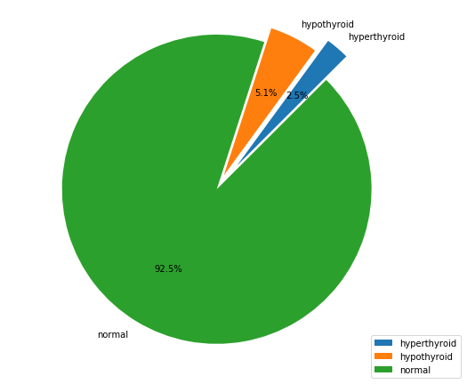
Exploratory Data Analysis
Percentage of people suffering from thyroid disease is very small.
Especially hyperthyroidism, which is particularly low (2.5%)
Most of the population is normal.

Slide 5
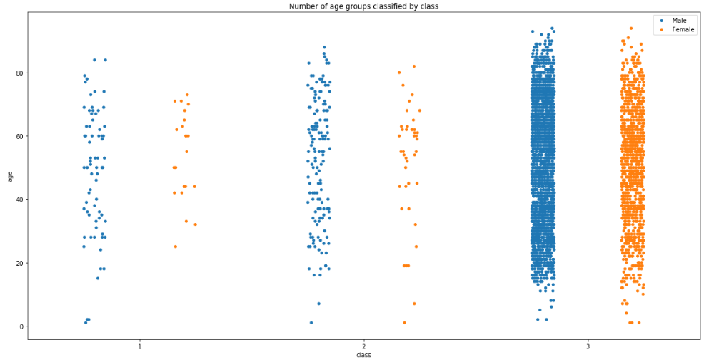
Distribution of classes per age group and gender.
Thyroid disease is spread across all age groups.
Class 1 – Hyperthyroid
Class 2 – Hypothyroid
Class 3 – Normal

Slide 6
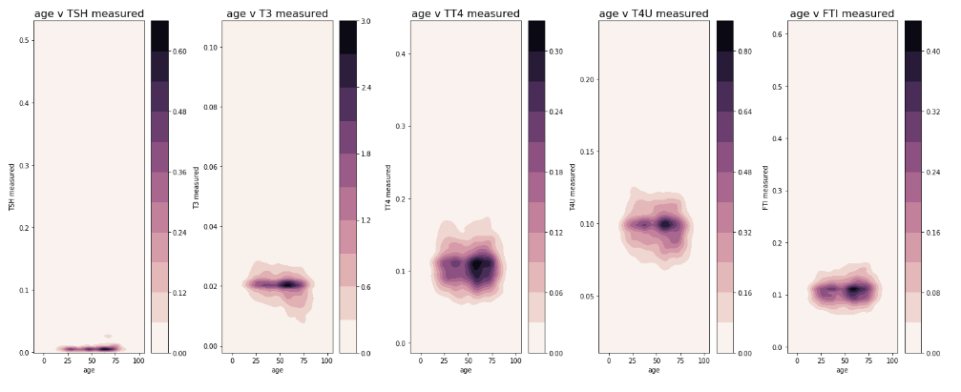
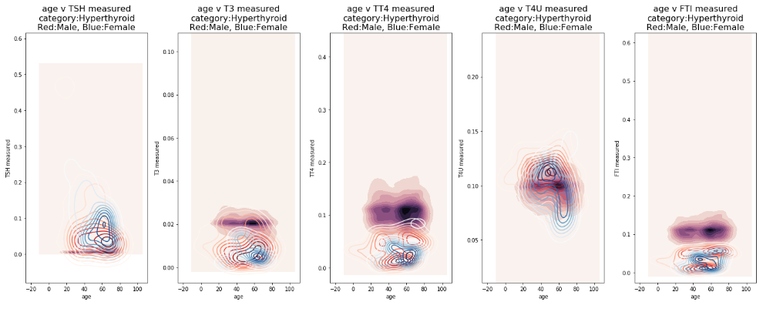
Density plots for TSH, T3, TT4, T4U, FTI measurements and age.

Slide 7
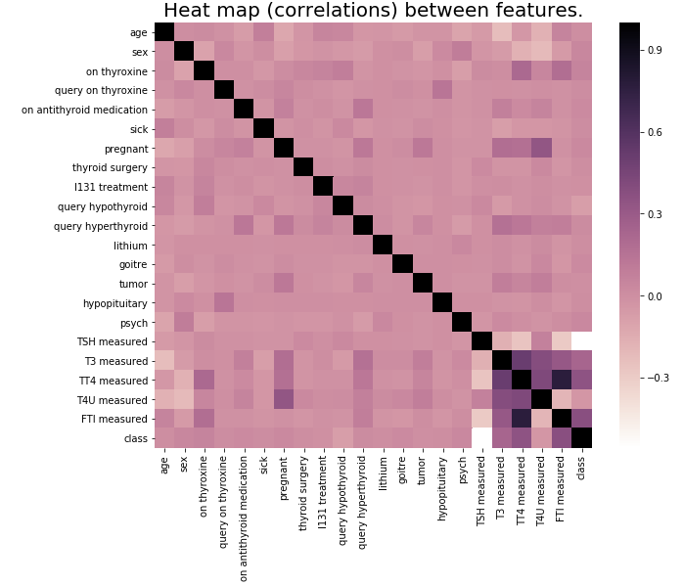
Correlation between features

Slide 8
Modeling & Machine Learning
Overview
Supervised learning
Multi-class Classification problem (3 classes)
Highly imbalanced data (~7.5% has thyroid disease)
Tools used: Python 3, Jupyter Notebook
Libraries used: Scikit-learn, imblearn

Slide 9
Resampling Techniques used
Resampling techniques using imblearn.
Synthetic Minority Over-sampling (SMOTE)
Random Under Sampler
Combine over- and under-sampling using SMOTE and Edited Nearest Neighbors (SMOTEENN)

Slide 10
Classification Algorithms and Techniques used
Logistic Regression
Tuning hyper-parameters
Applying Regularizations
Resampled data using SMOTE
Random Forest Classifier
Resampled data using SMOTE
Resampled data using RandomUnderSampler
Resampled data using SMOTEENN
Tuning hyper-parameters after applying SMOTE

Slide 11
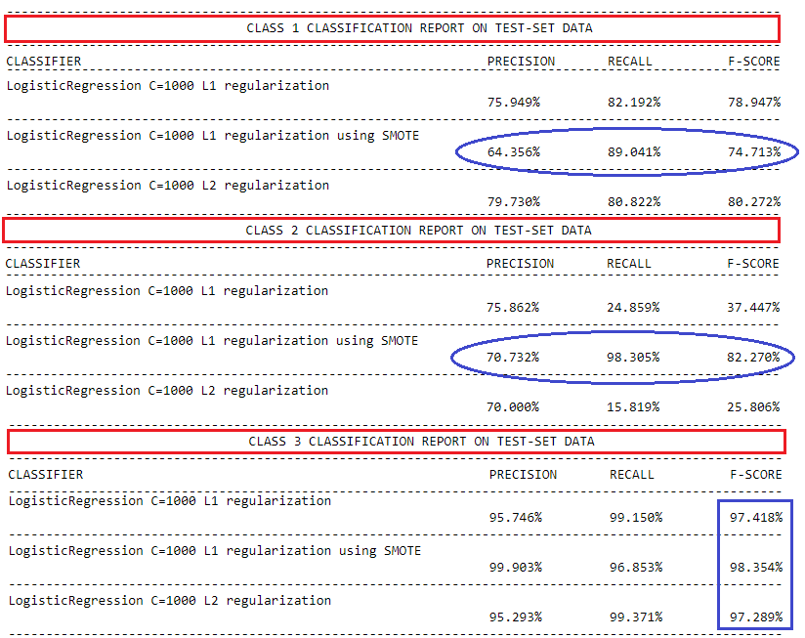
Logistic Regression
Recall for class 2 is low.
After applying SMOTE recall improved significantly.

Slide 12
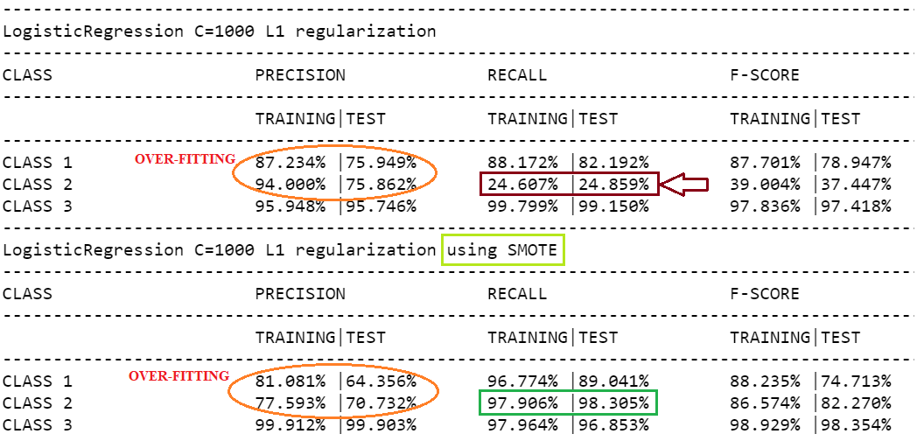
Over-fitting analysis
For Class 1 and 2 we see over-fitting happening.
After applying SMOTE we see some change but, over-fitting still exists.
Class 3 has the highest metrics amongst the classes.

Slide 13
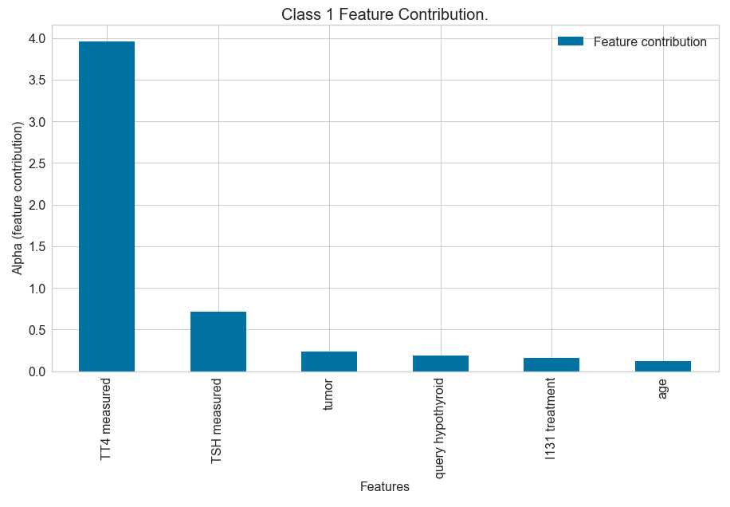
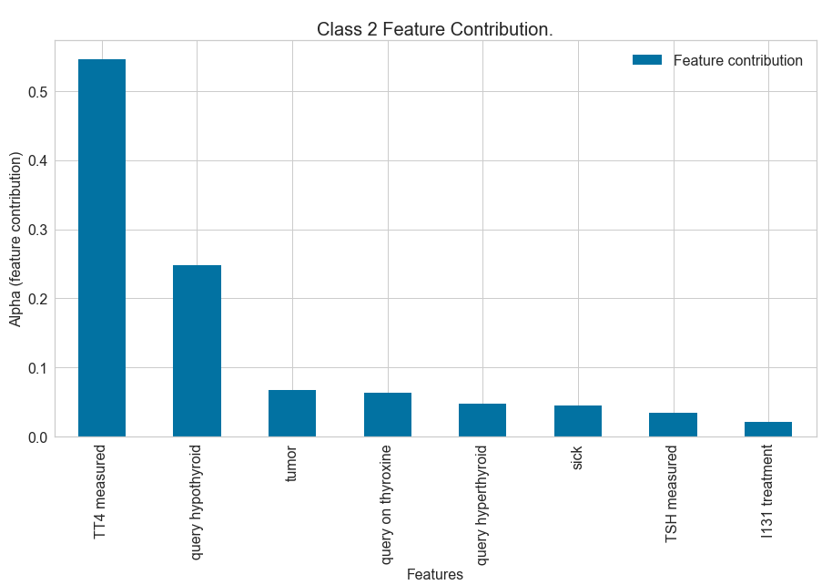
Feature Contribution

Slide 14
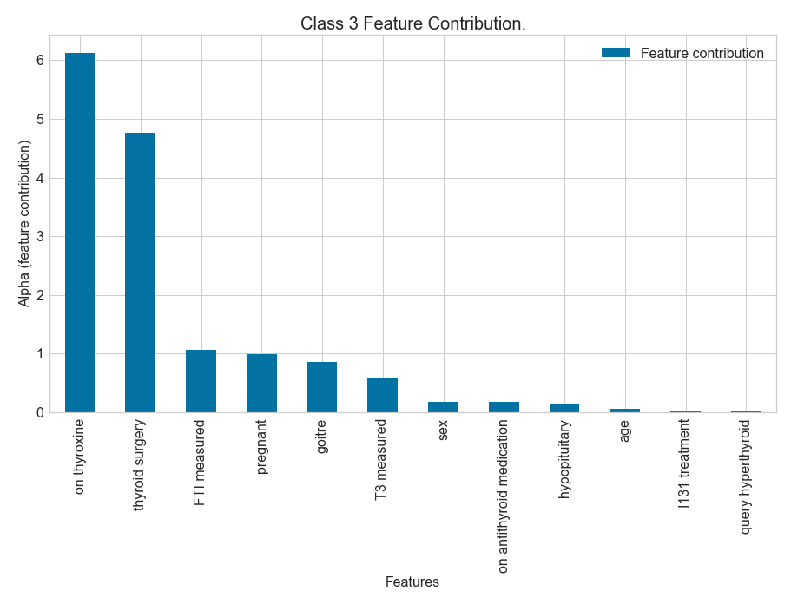

Slide 15
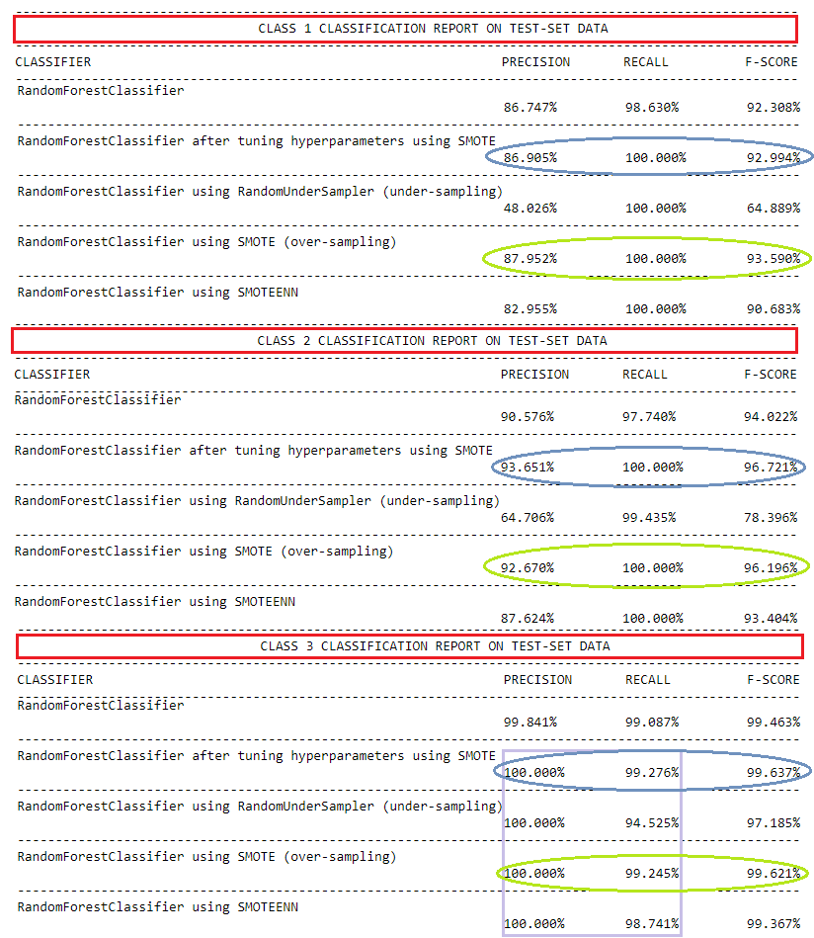
Random Forest Classifier
Default classifier performance is good.
Classifier trained using re-sampling techniques.
Classifier trained using SMOTE has a high recall (100%)
Classifier hyper-tuned and trained using SMOTE has similar metric.

Slide 16
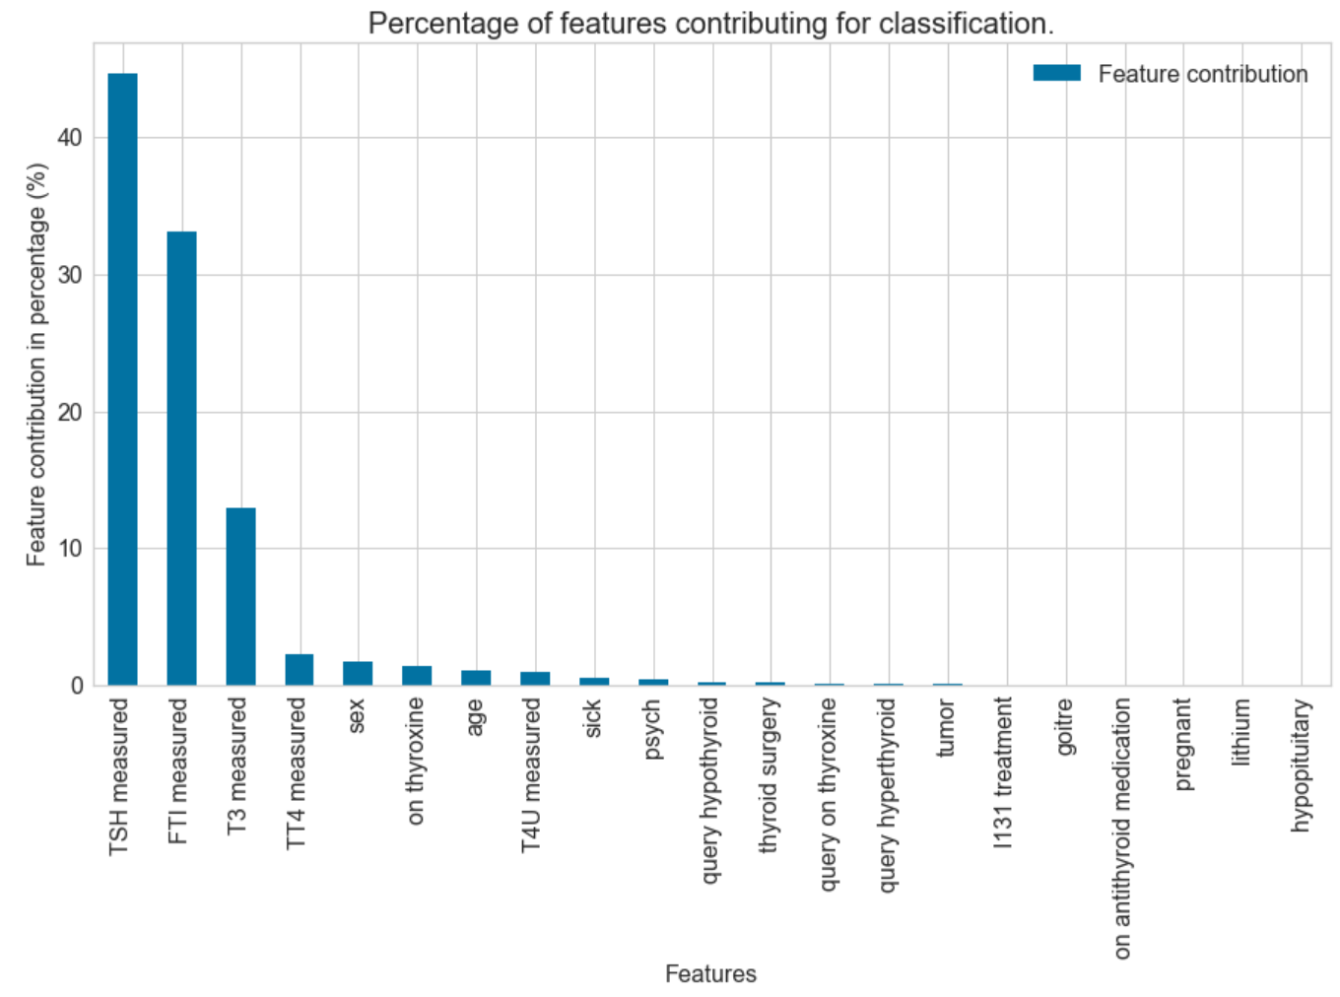
Feature Importance

Slide 17
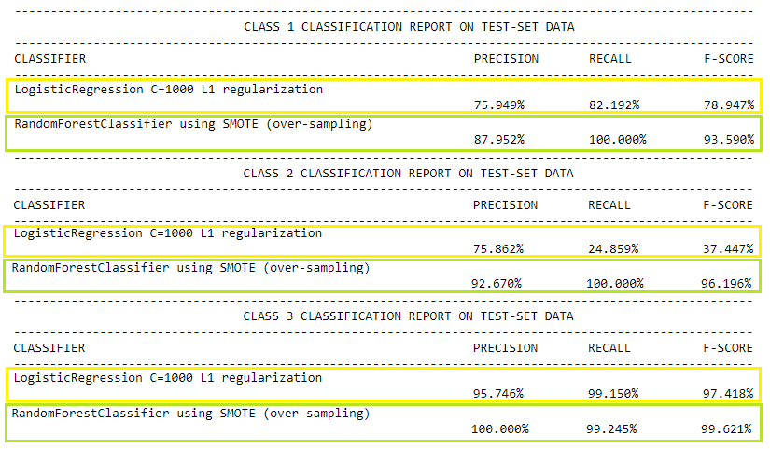
Model comparison
Base Model
LogisticRegression L1 regularization
Best Model
RandomForestClassifier using SMOTE

Slide 18
Findings
People suffering from thyroid disease is very low (imbalanced data).
Re-sampling was done to increase the classifier performance (maximizing minority class).
Random Forest Classifier using re-sampled data performed the best.
Model can be used by the physicians to make predictions.

Slide 19
Ideas for future research
If new data comes with existing features and additional features (height, weight) we can use those additional features to verify its contribution, correlation, etc.
If patient history is maintained or tracked, we can add more data and engineer more features.
After treatment is administered, measurements are to be noted before and after so to understand the effectiveness of the treatment, which can provide additional features for different types of treatments.
With more data and features we are not only trying to make better predictions, but understanding connections between the features.

Slide 20
Recommendations
There are few features that are dominating the prediction in classifying thyroid disease, physicians need to understand why those measurements are high is it because of genetics, heredity, dietary, life style or other factors.
The model can aid the physician as a preliminary diagnosis tool in decision making but still physicians need to look at the test results to avoid any false positives or false negatives.
Model was built on data provided, there could be other unknown factors affecting the patients which was not accounted for or might not considered (blood pressure, diabetics, etc.).

Slide 21
Thank you.

